Slide 1
WCW Shooting Sports
Quarterly Member’s Meeting

Slide 2
300 New Members in 2023
  Thank you for joining
  Enjoy everything your club has to offer
  Get involved to help your club

Slide 3

Snohomish Domestic Violence Services
Holiday Food/Toy Drive
Nearly $2500 was donated to this very worthy cause
“Thank You” to everyone who contributed!
DVS is the county’s only program providing emergency shelter and services to victims of domestic abuse.

Slide 4
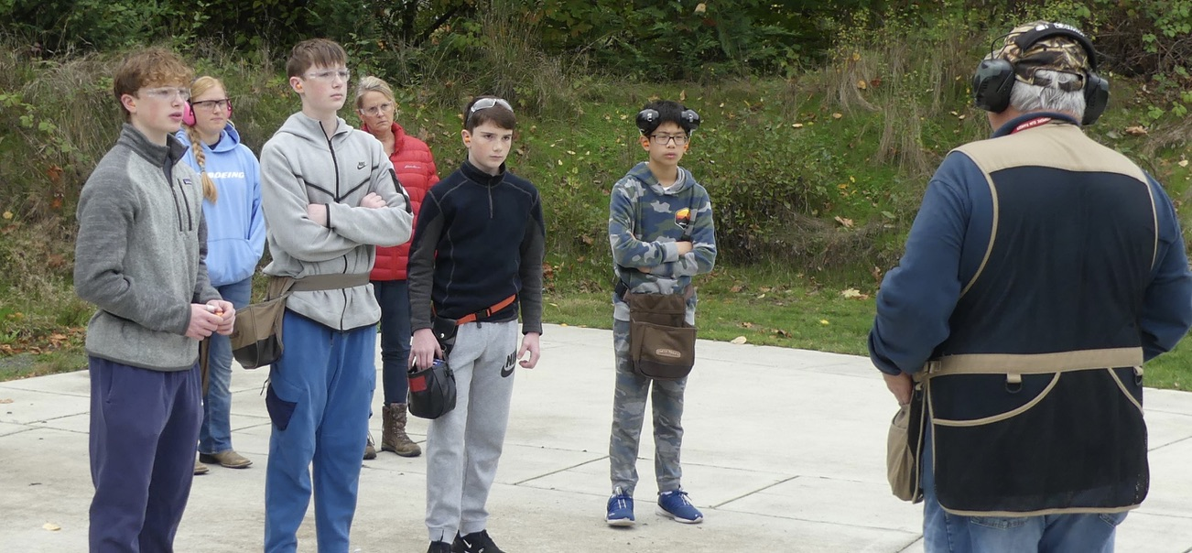
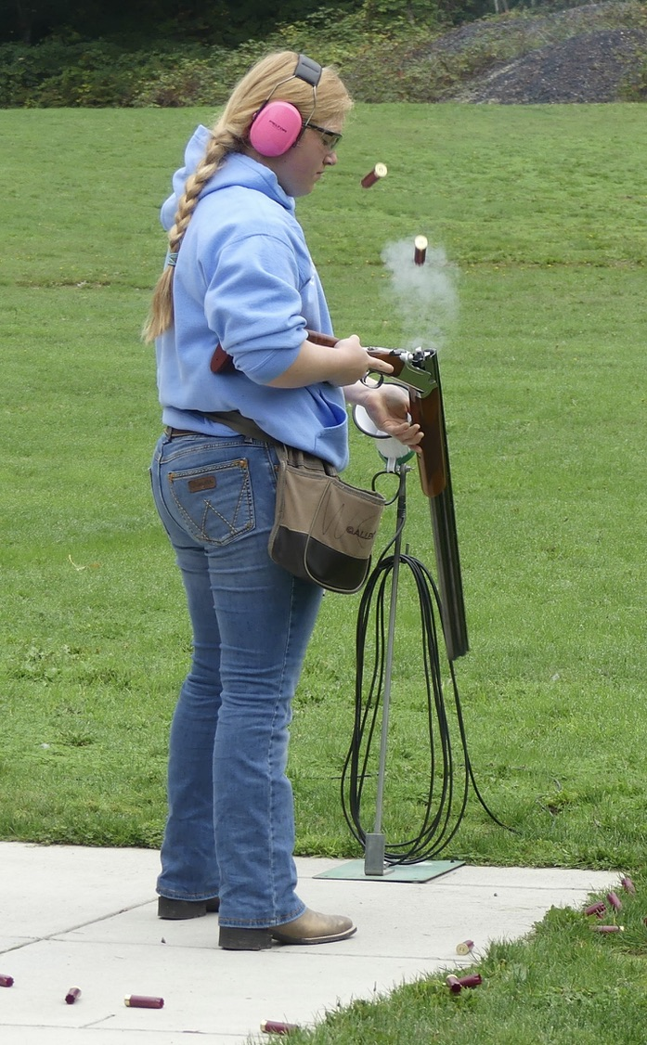
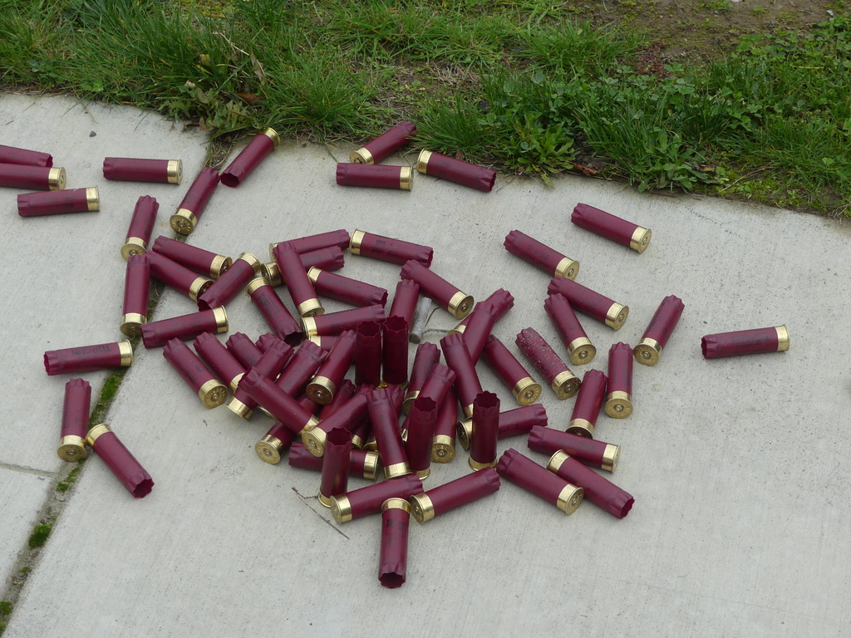
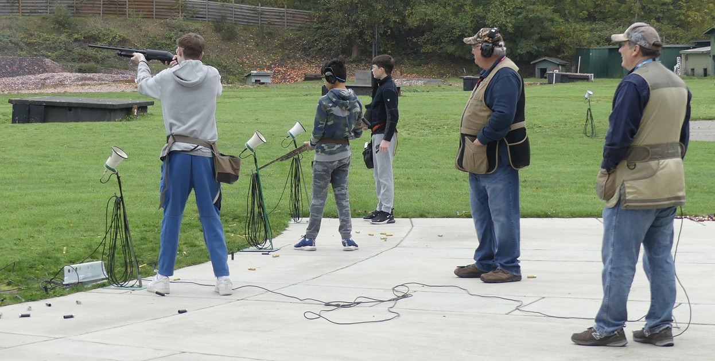
Youth Shotgun League
Training New Shooters, Inspiring the Next Generation

Slide 5

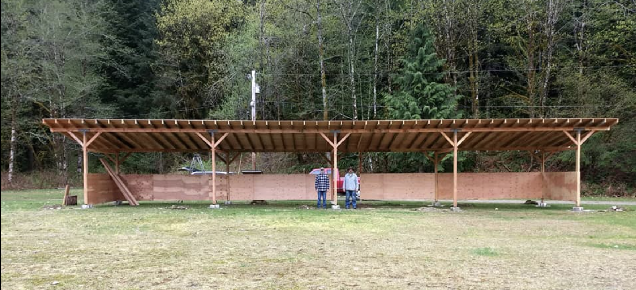
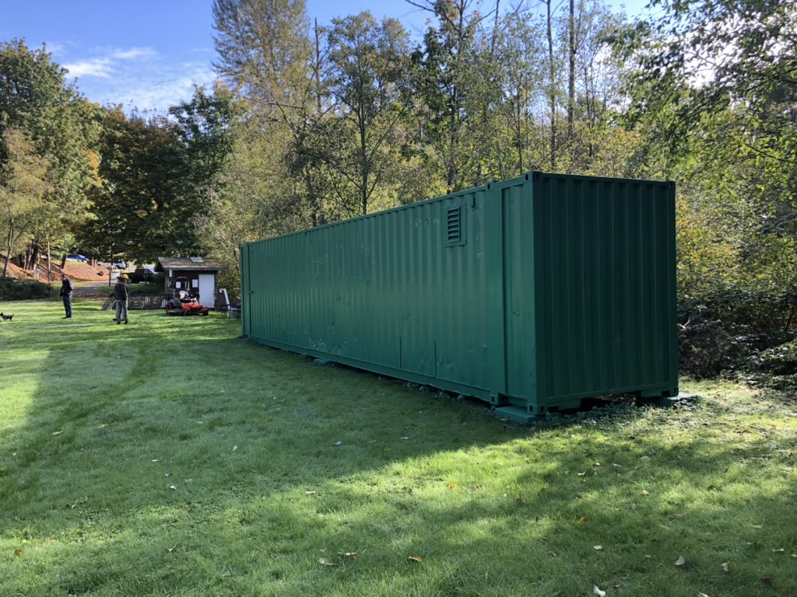
$5000 Grant from Next Step Archery
To build archery shooting pavilion on Olympic Range

Slide 6


Police Department Outreach
Encourage Police Departments to rent ranges for Officer Training
Local, Regional and State Law enforcement agencies

Slide 7
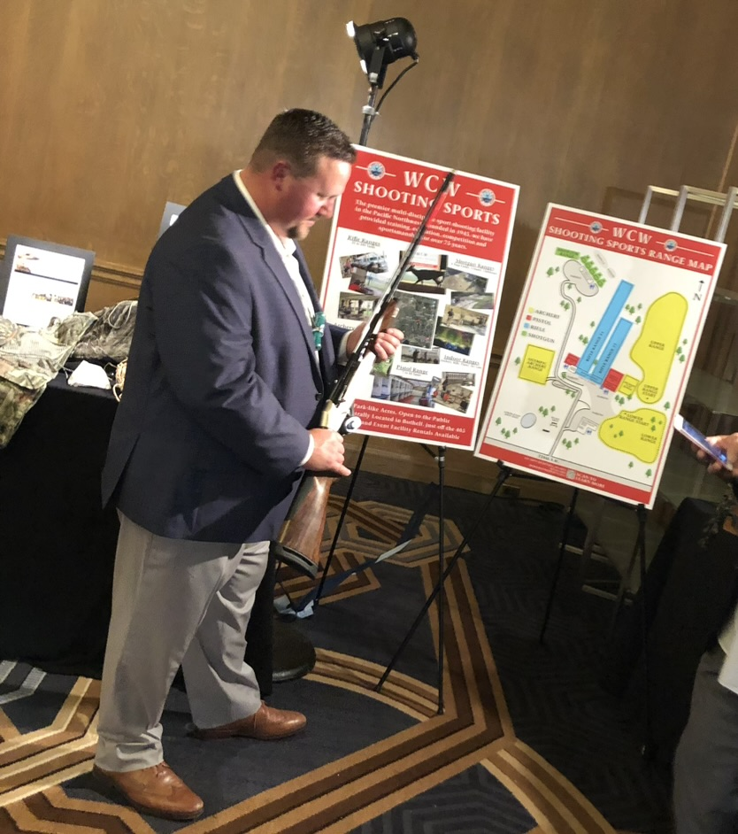


Wildlife Conservation Organizations Outreach
WCW Shooting Sports supports
  Ducks Unlimited and Rocky Mountain Elk Foundation Banquets
Drives visibility for WCW with like-minded
people and organizations
Encourages them to become members and
rent our facilities for their events

Slide 8

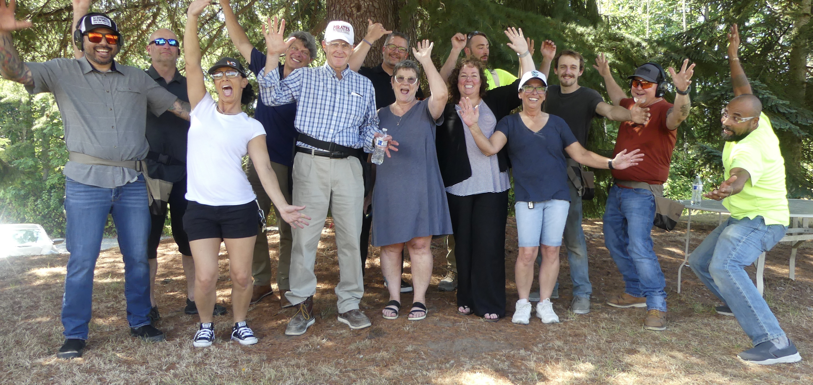
Earn Revenue through Corporate Events
Returning for Team Building Event
Renting Shotgun Range and Clubhouse

Slide 9
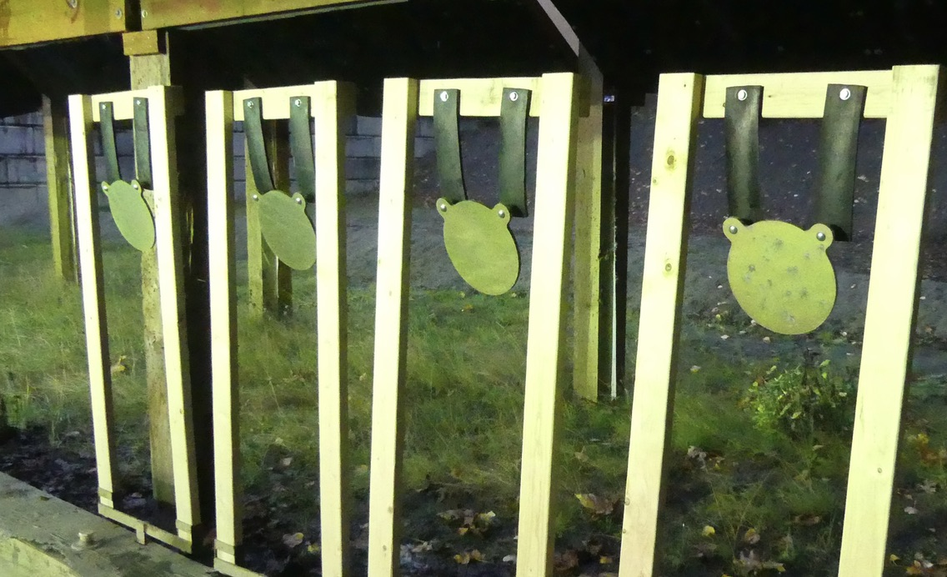
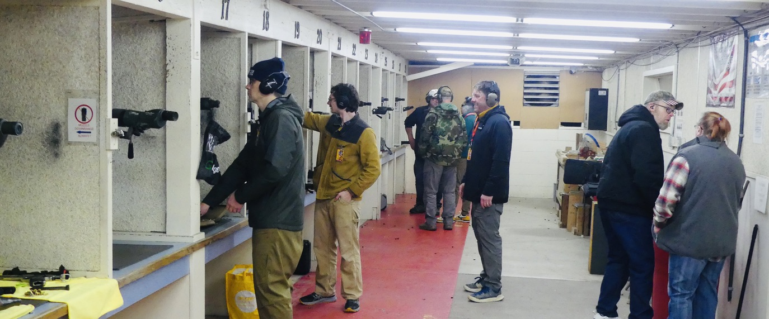
Pistol Special Use Member’s Night
January 19th, 4pm-on, Pistol Classroom and Range 3
Try out our new Steel targets at 25 yards!
221 New Pistol Special Use endorsements in 2023
Special Use Class and Range Session January 28

Slide 10
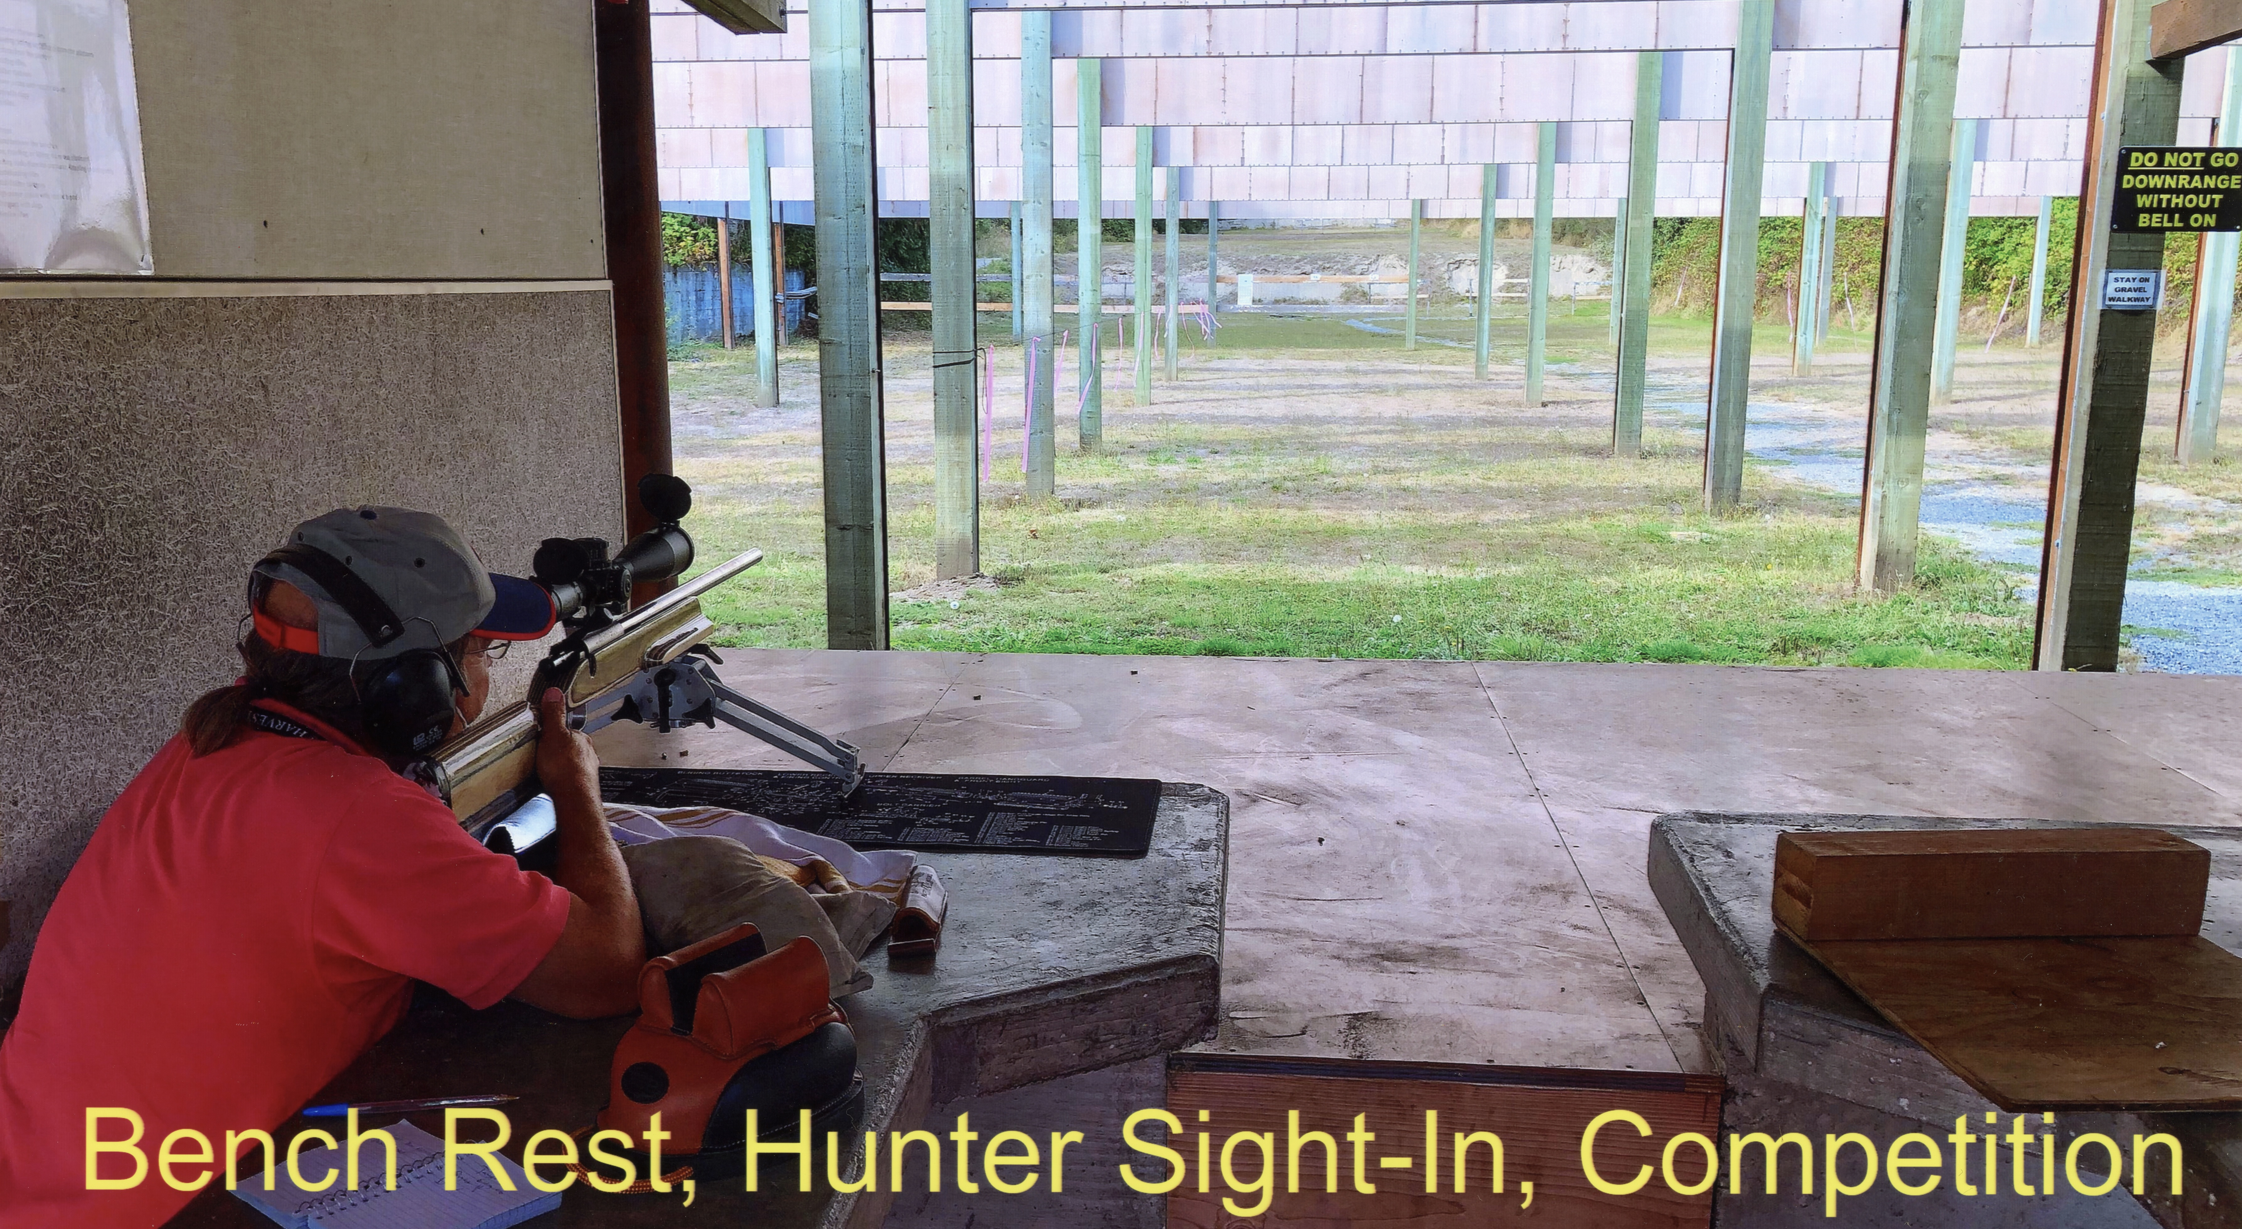
Rifle Update
199 Special Use Endorsements in 2023
Steel Targets now available on Range 1!
Special Use Class and Range Session January 28

Slide 11
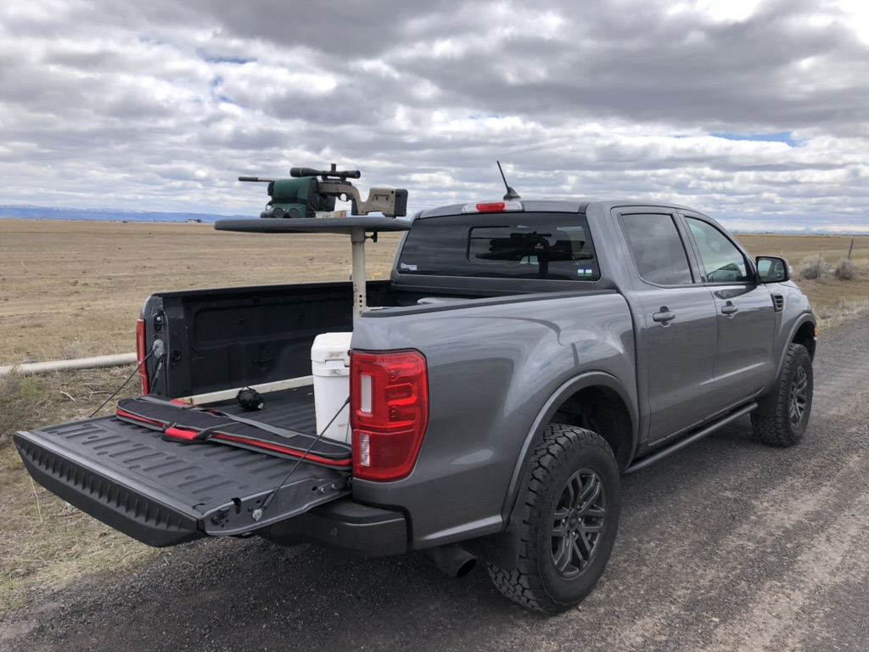
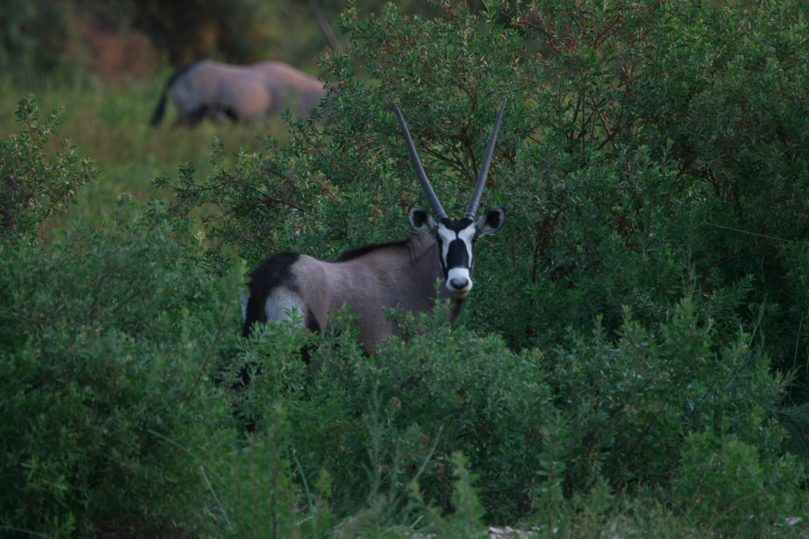
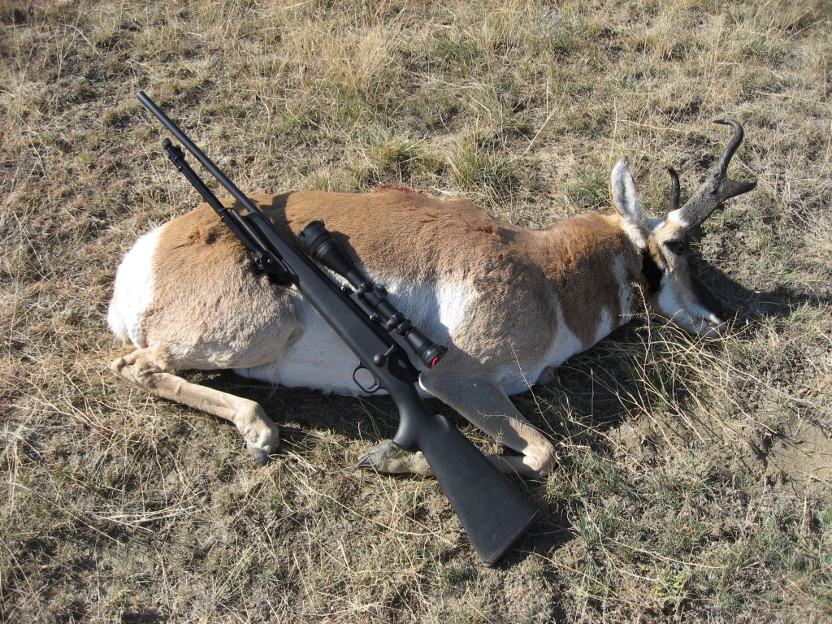
New Activity: Hunters Group Monthly Meeting
Saturday, January 27, 10 AM - 12 PM
Pistol Range Classroom
Compare notes, learn about hunting opportunities
Tell Tall Tales……..

Slide 12

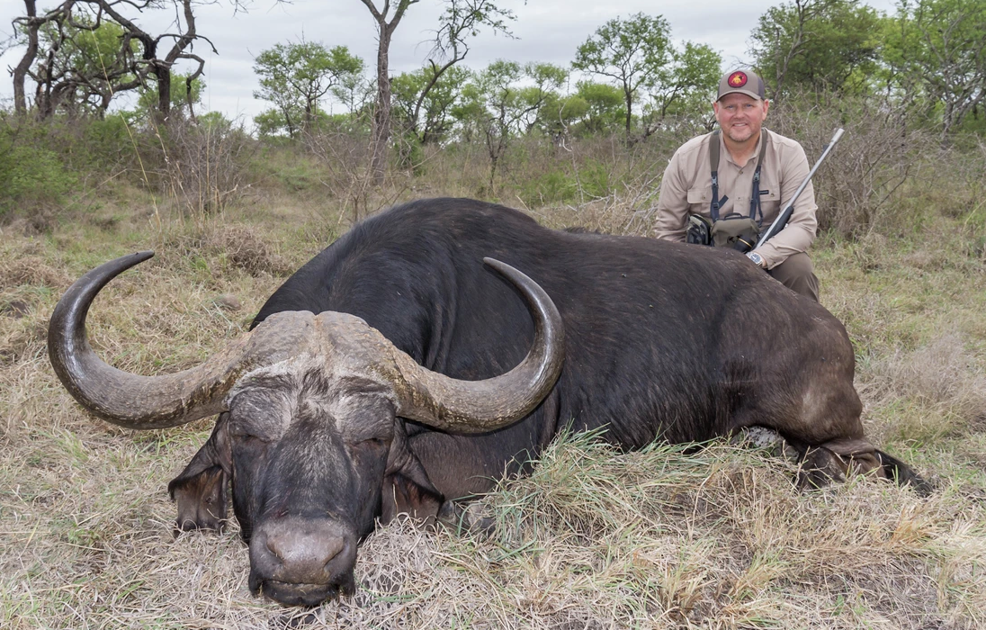
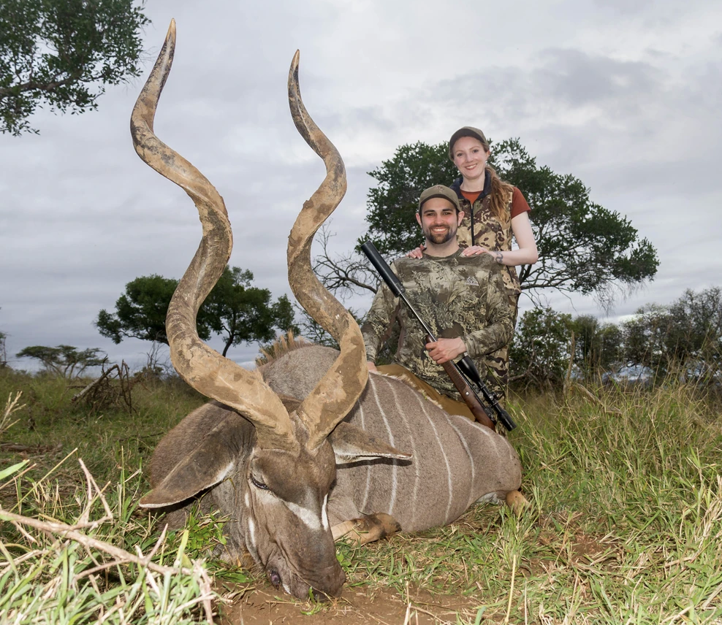
African Safari Outfitter Presentation
February 6th, 6:30 pm, WCW Clubhouse

Slide 13

Coming Soon: Membership Survey
We want to hear your thoughts and ideas about your club

Slide 14
Board Member Election: April
Submit your notice of intent to run by February 29th
  At the front desk or give to a current Board member
Ballots mailed out in March
Votes counted and results announced at Annual Member’s Meeting
  April 10

Slide 15
Thank You!
Happy New Year!

