Slide 1
WELCOME TO the RIFLE & Handgun JOINT Meeting
Please sign in on ‘chat’
Name, email, and if for rifle or pistol or both
Agenda:
Special Use Presentation
Committee Updates
Activities report
Discussion topics
Safety Tips & Concerns

Slide 2
SPECIAL USE Agenda
General Information and Rules
Special Use Common Features
Rifle Range review
Pistol Range review
Questions , Comments, Suggestions

Slide 3
Special Use – Overview
Special Use Permits grant privileges to members not otherwise available and they can be revoked.
The training today covers the use of Ranges 1, 2, and 3. Your range session will complete the special use training.
Members must apply for Pistol and/or Rifle Special Use in person then renew it every 7 years.
Your membership card will be replaced after completing your special use requirement.

Slide 4
Membership CARD / Badge
Your approved Special Use is printed on the back of your membership card.
All members using Special Use (members-only) hours or facilities MUST wear their membership card / badge in plain sight.
All dependents must be directly supervised by the member with Special Use.

Slide 5
Differences in handgun and Rifle Special Use Process
RIFLE –
Attend this Joint Special Use Training / Range meeting.
Attend Special use class on the range.
Complete Special Use Request form.
HANDGUN –
Complete Probation card at Range 3 with the Rangemasters
Attend this Joint Special Use Training / Range meeting.
Complete your Special Use Request form. Please include all your endorsements.

Slide 6
Rifle Special Use Process
Sign up on the club calendar for Rifle Special Use class
Attend the class, bring your rifle and ten rounds of ammunition.
The class covers the operational and design limits of our ranges.
You will demonstrate safe rifle handling.
You will learn how to act as an acting rangemaster.

Slide 7
Handgun Special Use Process
To get your first Pistol Special Use permissions you must complete and fill out the Pistol Probation card (example below) by having the Rangemaster sign-off on your safe use of the range.
You can get a Pistol Probation Card from
a Rangemaster on Range 3
at the Range office (public)
Rangemaster descretion

Slide 8
handgun Qualification
There are 3 positions you may qualify to shoot from:
One Handed (‘off-hand’)
Two Handed
Using a Rest
Pistol Caliber Qualification - Minimum Qualifying Score for 10 shots is either 60% at 25 yds or 80% at 15 yds.
You may then fire that caliber, and any smaller, during members-only hours.
You may only use the position qualified to fire from, and those less difficult.

Slide 9
handgun PROBATION (1st)
Range use during your probation period is confined to the public business hours.
Make sure you get the Probation card signed and dated by the Rangemaster for each visit. (minimum 2 visits)
Receive training on the Key Handgun Range Proficiencies from the Rangemasters (initialed on your Probation card)
Proper firearm handling at the range
Guidance on safe shooting skills
What to do if the firearm doesn’t fire
How to conduct a ceasefire
Responding to an emergency
Shoot to qualify for your special use – caliber and position.
Notes:
The Rangemaster ensures that the member shows hands-on proficiency in several key areas during their 6 probationary visits, signing them off on the probation card as completed. They are:
Proper firearm handling at the range, including the requirements for casing and uncasing, holster policy, ECI usage, etc.
Guidance on safe shooting skills (sight alignment, sight picture, trigger control, follow through, etc.) so the member can hit the paper consistently.
What to do if the firearm doesn’t fire – handling misfires, hang fires and sqibs.
How to conduct a ceasefire.
Responding to an emergency.

Slide 10
RENEW SPECIAL USE
Every 7 years
Obtain your new membership card.
Rifle and Pistol: Attend this Joint Special Use Training / Range meeting.
Pistol: Bring either your original Probation/Qualification requirements or the prior year’s membership card with special use indicated.
Complete and turn in a new Special Use Request form. For pistol, include all your endorsements.

Slide 11
QUESTIONS?

Slide 12
General Special Use responsibilities – applies to all ranges

Slide 13
MEMBER HOURS
Member Hours are from 9:01 AM until public hours begin.
No shooting before 9:01 AM for any reason.
Everyone inside the gate during members-only hours must have a key. Keys can be purchased at the range office.
Allow no one access that doesn't have a key.
Leave the gate as you found it.
Ranges close for all when the range office closes for the day.

Slide 14
Range Maintenance
Ranges may be closed periodically for maintenance.
No firearms are allowed on a range that is closed for maintenance.
Maintenance takes precedence over general shooting.
Members are encouraged to volunteer to participate in range maintenance.

Slide 15
Special Events
Special events (such as: matches and classes) must be approved at range committee meetings and by the board of directors. When approved, the event will then be added to the calendar.
Special events have the highest range use priority.
Special events have use of the facility for the entire scheduled time... usually half or full day.

Slide 16
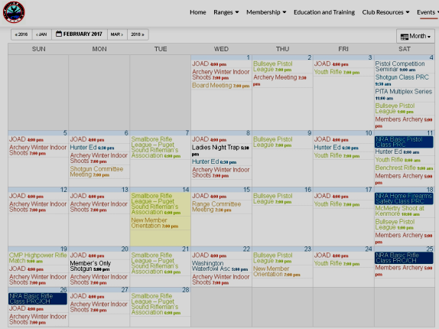
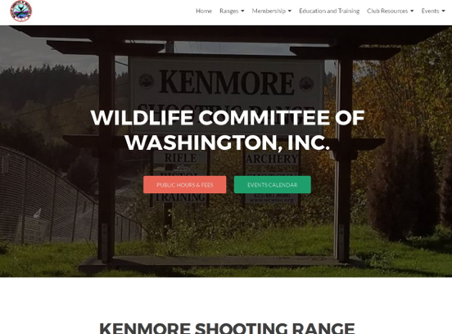
WCW CALENDAR
http://wcwi.org/
https://www.facebook.com/wcwiorg
https://twitter.com/wcwiorg
https://www.instagram.com/wcwiorg/

Slide 17
MEMBER Responsibility
Our shooting is monitored by range employees and by recording cameras which are routinely reviewed.
The hierarchy of authority on the ranges is: Club Officer, Board Member, Rangemaster, Assistant Rangemaster, Temporary Rangemaster, Club Committee Chair, Special Use Holder, Club Member, Public Shooter.
Members are expected to be familiar with all club rules.

Slide 18
MEMBER Responsibility
Members are expected to courteously but firmly ensure everyone is obeying the club rules and By-laws.
Should someone refuse to comply with our rules, the next higher person in the above hierarchy must be immediately notified.
Club Members who observe safety or range use violations without taking immediate action can be suspended.
See something, say something.

Slide 19
Family Members
A member with a Family Membership and a Special Use permit can bring their spouse or dependent children and directly supervise their shooting activity.
Everyone MUST be skilled enough to hit the target paper with every shot.
We have NRA certified classes and instructors if anyone would like training.

Slide 20
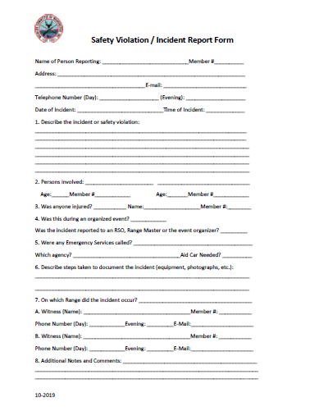
Incident Report form
Immediately fill out an incident form to report safety violations, hazardous situations, etc. Turn it in at the range office

Slide 21
General Special Use responsibilities – applies to all ranges

Slide 22
Sign In Sheets – Postings
Sign in and out (even during public hours)
useful for EMERGENCIES
usage analysis
See range rules and other useful postings on the wall and noticeboard.

Slide 23
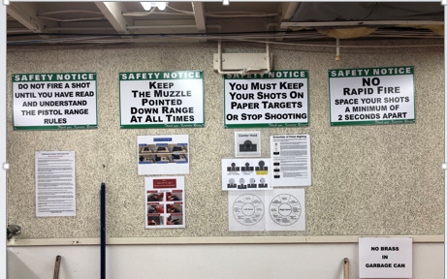
Range Rules and Guidance

Slide 24
Firearms Safety
It is preferred that firearms be cased until taken to the firing line.
You must take your case to the bay or bench you will be firing from, with the muzzle pointed downrange, before uncasing the firearm.
Firearms which are not in a case must have the action opened and a chamber safety flag inserted before being brought onto the range.
You must NEVER ‘cover’ [point at] another shooter or any part of your own body with the muzzle of your firearm.

Slide 25
SAFE SHOOTING
Every shooter must hit the paper target with each shot.
Small frame or minimal sight pistols should use only the targets at 7 yards distance.
No rapid firing or double-taps. The minimum time period between shots is TWO seconds. (Bang – “one Mississippi – two Mississippi” – Bang !)

Slide 26
Holster Policy
WCW does not prevent CPL holders from exercising their permitted state right to conceal a handgun.
Once the handgun is removed from concealment to shoot on our range, it becomes a ‘range gun’. All range safety rules apply. It must be carried back to your vehicle in a case, or with action open and chamber flag inserted.
You may not re-holster your firearm while on our range.
Rangemasters strongly prefer that you arrive on the range with your handgun in its case or a range bag.
About ‘open carry’ of handguns: Prohibited. (by club policy as an incorporated business).

Slide 27
Prohibited ON OUR RANGES
No rifles or shotguns of any barrel length are allowed on Range 3.
No shot shells on Ranges 1, 2 or 3.
No cartridge derived from the .50 Browning case.
No high power rifle cartridges on Range 3.
No Tracers – of any type.
No Armor Piercing Ammunition.
No Multi-Projectile Loads such as:
.410 Winchester ‘PDX’ Disc
Black powder ‘Buck and Ball’
When in doubt, check it out with a Rangemaster

Slide 28
Black Powder
Load only from a powder measure.
No powder or cap containers left open on the firing line.
No smoking!
Un-loaded means no powder or ball in the barrel; or in any chamber of a revolver.
Your firearm must be completely empty before changing targets.

Slide 29
HANDLING Firearm MALFUNCTIONS
Misfire – This is a failure of the cartridge to ignite. CLICK – NO BANG
Hangfire - This is a perceptible delay between the fall of the striker or hammer and the cartridge ignition. CLICK – PAUSE - BANG.
Squib - This is a defective cartridge which partially ignites. CLICK – POP. [SOFT OR NO BANG.] Highly Hazardous!

Slide 30
HANDLING Firearm MALFUNCTIONS
There is no way of immediately knowing if you had a misfire or a hangfire:
SO – wait 30 seconds with the sights fixed on the target, before opening your action.
Then remove the magazine / ammo, then the failed round and inspect it.
CHECK:
The removed cartridge : is it 100% intact?
The firearm : is the bore obstructed?

Slide 31
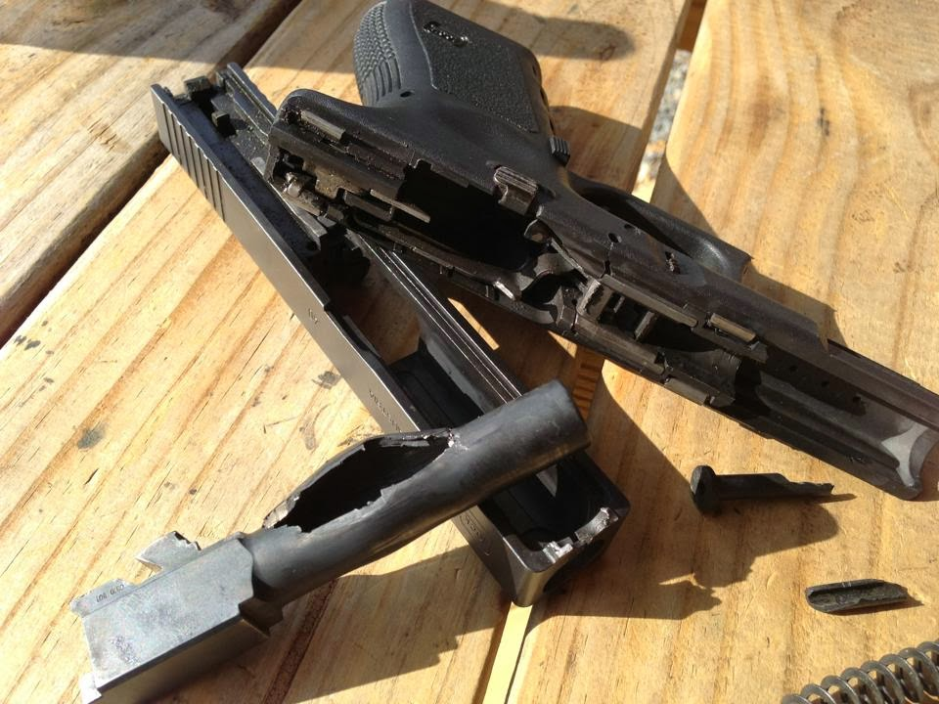
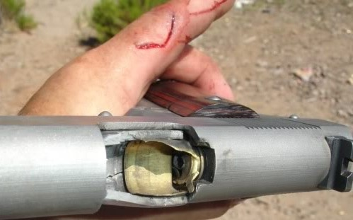
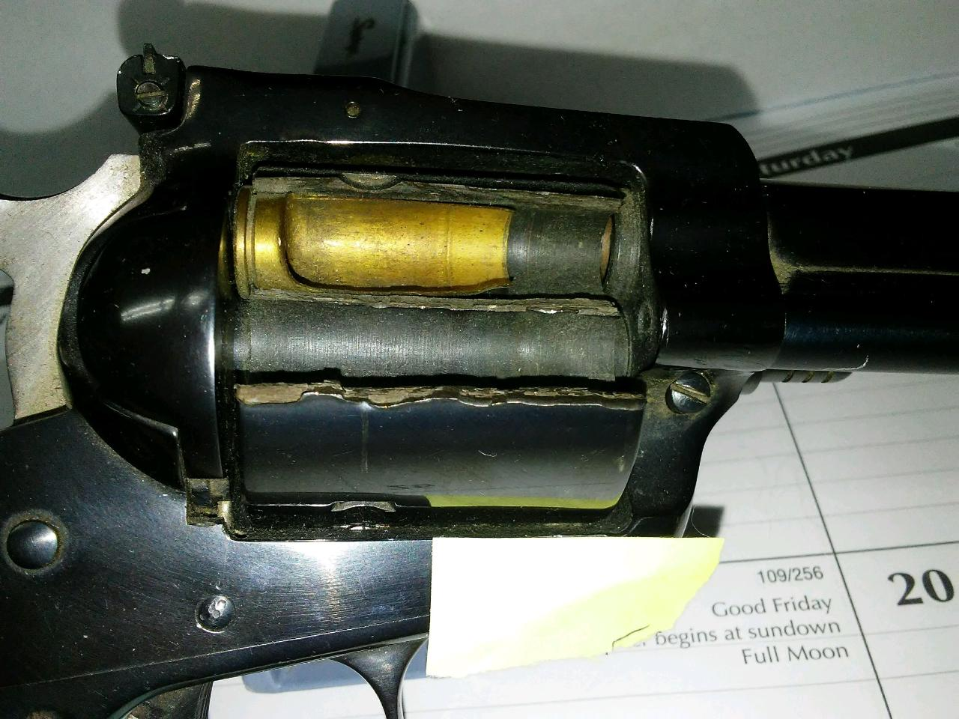
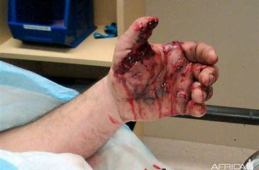
Squib accidents

Slide 32
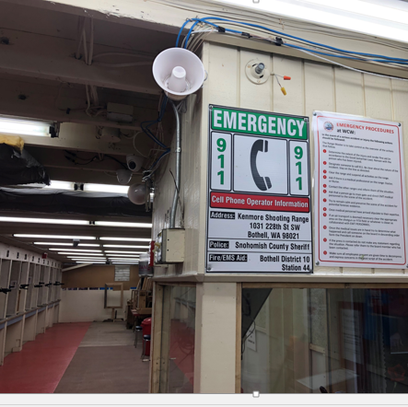
Emergencies
There is a phone and a direct dial 911 phone at the Main Range Office (and Shotgun Range Office).
IMPORTANT : Instructions for CELL PHONE use are posted on each range. Familiarize yourself with them.
“There has been an accident.” add clear details, stay on the line.

Slide 33
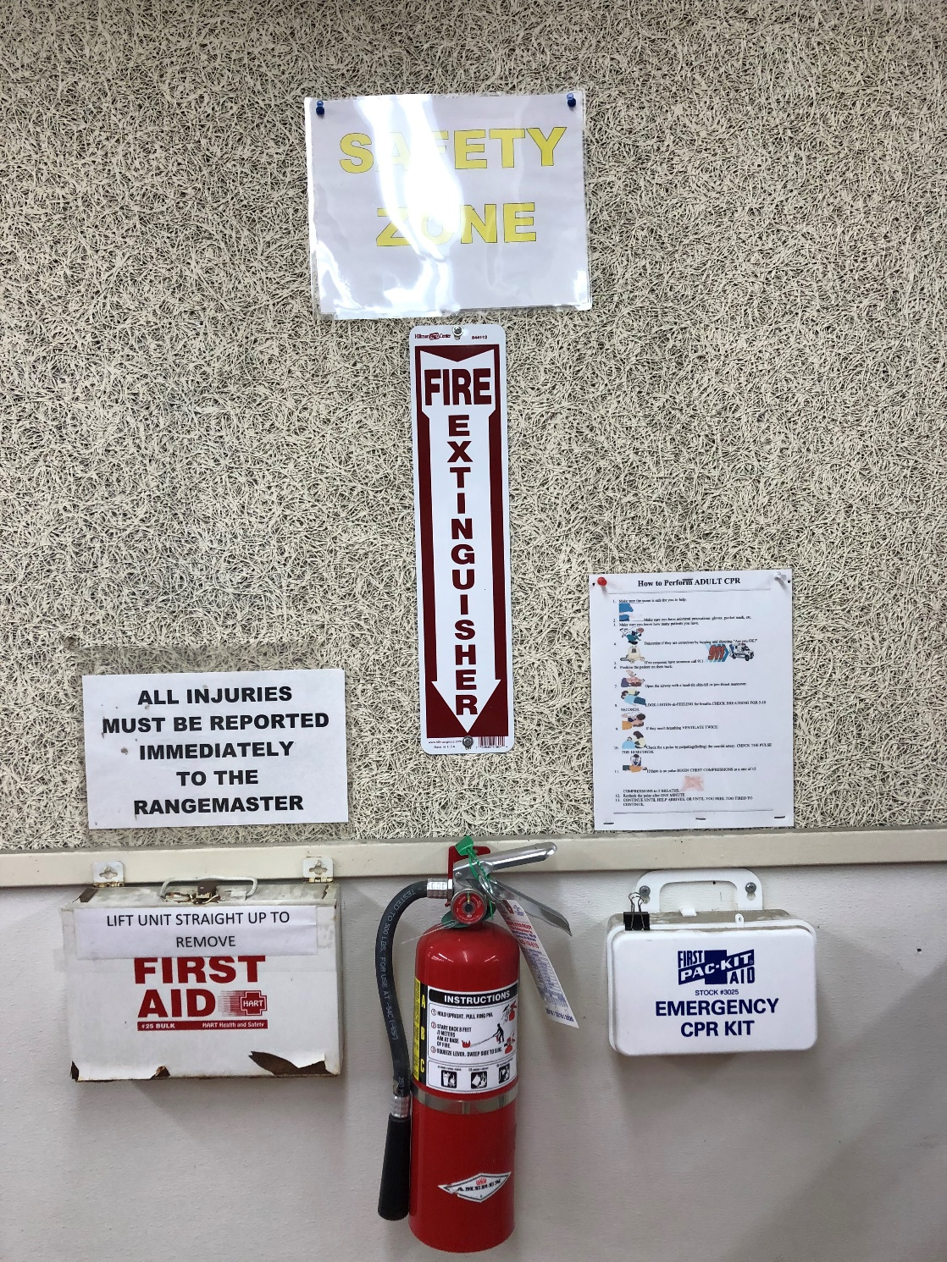
FIRST AID
Every range has First Aid, CPR and a fire extinguisher.
The first aid container - routine items like Band-Aids.
The CPR container (blue) is sealed…open only when needed.

Slide 34
First Aid - AED’s
Defibrillators: AED’s are located at the Main Range (public) and shotgun offices.
These defibrillators are housed in an alarmed – but not locked – cabinet.
If they are needed, also have someone immediately dial 911!
Key box at the gate so ER responders can get in if you are alone

Slide 35
Keep your range clean
Remove targets from downrange before leaving.
Clean up the rest of your area: brass, ammo boxes, etc.
Leave it better than you found it.

Slide 36
Rifle Range Special Use
Rifle range Special Use procedures will be taught during your range session.

Slide 37
Ceasefires
Called by members’ agreement on unsupervised ranges.
The Acting Rangemaster will:
Walk the entire range to Check that all firearms are unloaded, actions are open, a chamber flag has been inserted, and detachable magazines removed.
Clear the RED ZONE. (Count the shooters)
Activate the bell and release shooters to go down range.

Slide 38
Ceasefires
The acting Rangemaster stays on the range during the ceasefire, takes the key if going to the Range 1 targets.
Let the acting Rangemaster know if you are leaving the range.
The Acting Rangemaster will:
Make sure everyone has returned from the targets.
Turn off the bell and allow shooting to resume.

Slide 39
Details
50, 100, 200, 300 yard targets only.
One target per firing point. No silhouette targets.
Shooting allowed from bench, standing, prone, kneeling, sitting, or shooting sticks.
200 or 300 yard shooting from the bench or from prone only.
Take down unused target frames if they are behind the frame you are using.
Shotguns allowed with slugs. Short-barreled rifles, high-power pistols, bullpups, pistol-caliber carbines, blackpowder rifles allowed.

Slide 40
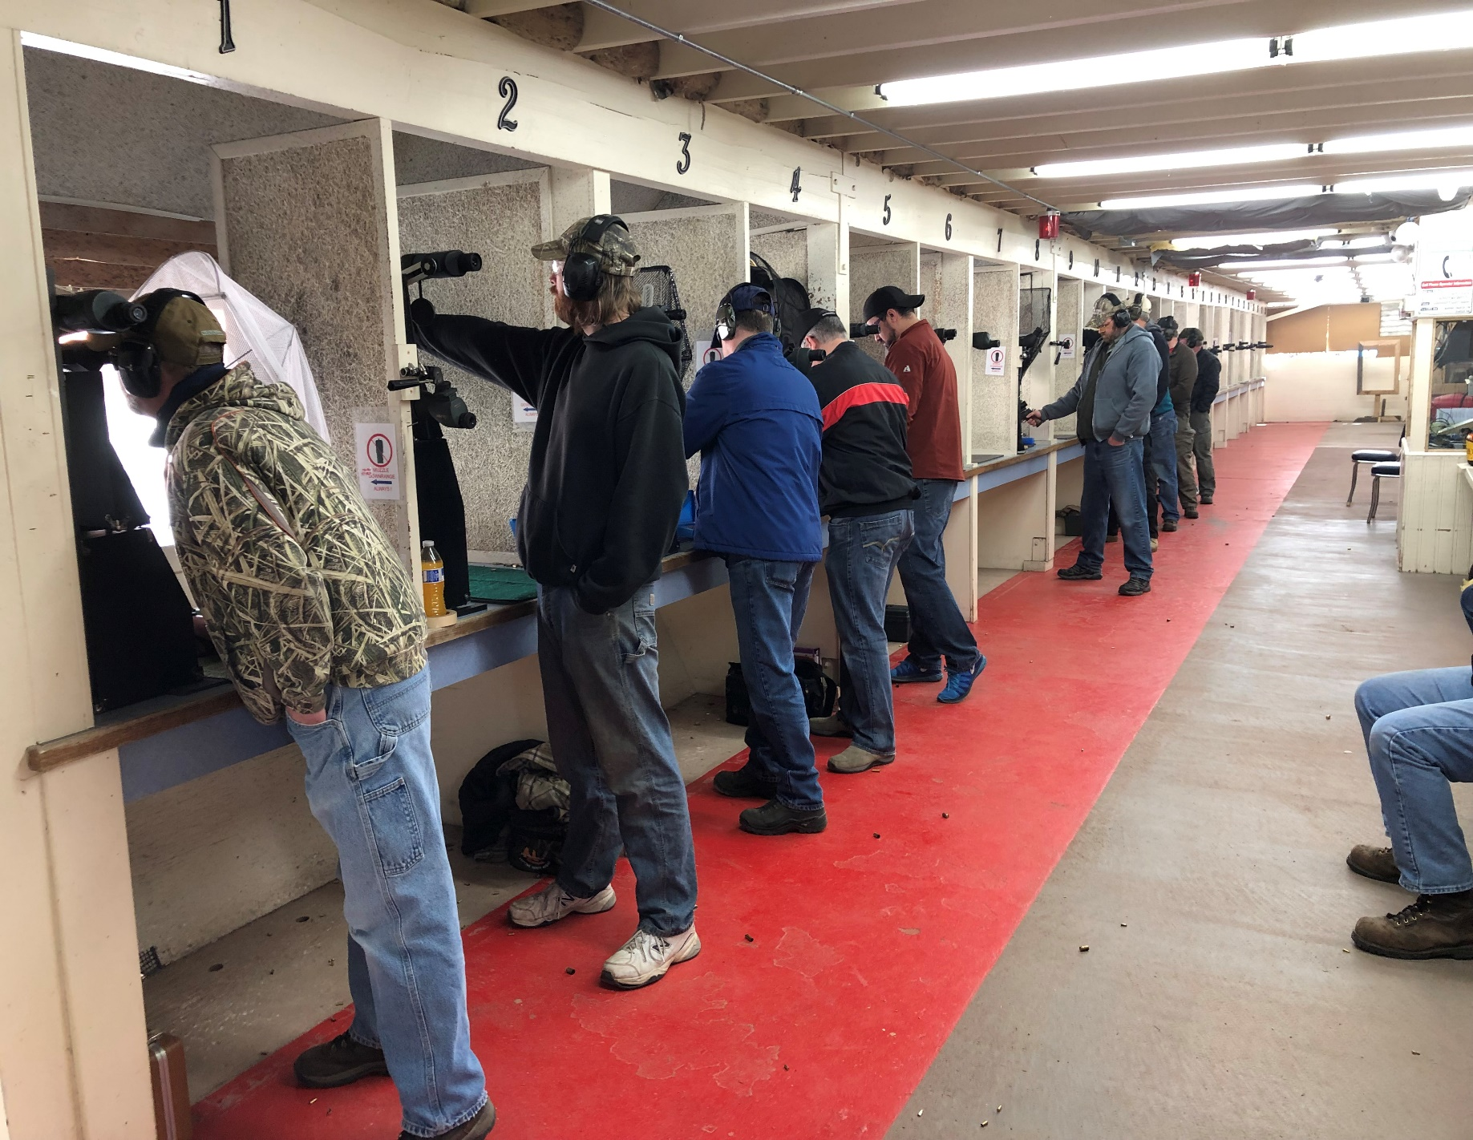
Range 3 Special use
Pistol range Special Use procedures will be taught during your range session.

Slide 41
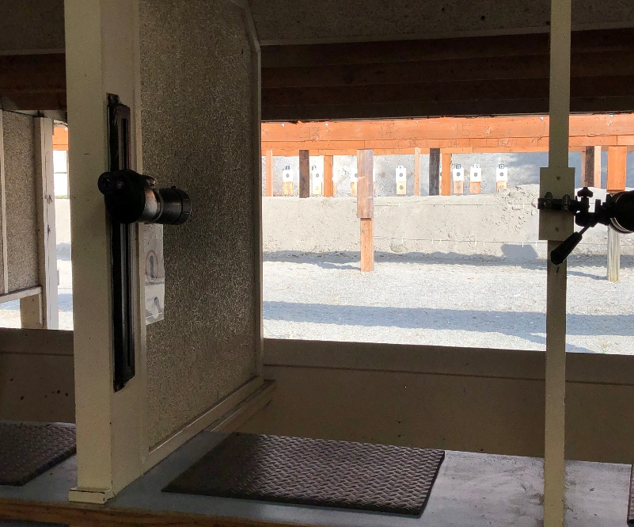
Targets
7, 15, 25 and 50 yard targets only.
Multiple targets hung on a frame are not allowed. No silhouette targets
Use only 1 target directly downrange from your firing point, centered in the frame (positions are numbered).
Use only approved targets and spots.
No spots on 7 yards except within the bullseye.
Otherwise spots should be set touching main bull.

Slide 42
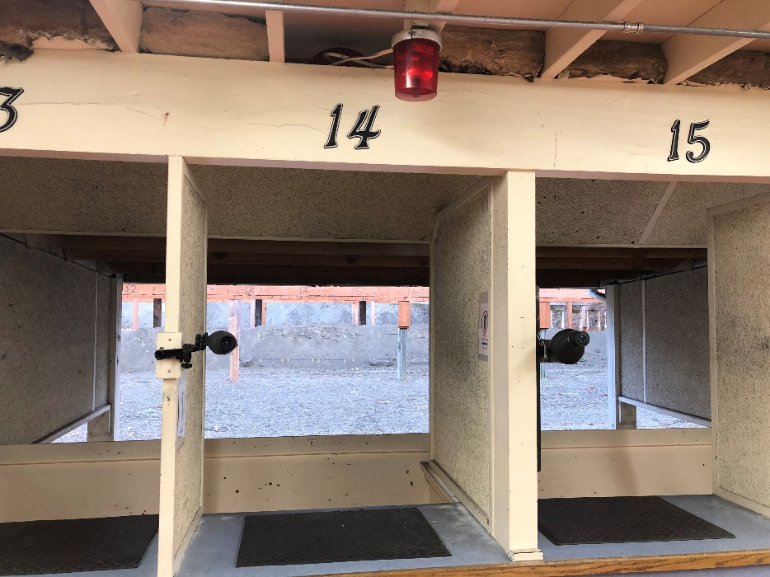
Ceasefire termination
Once targets change is completed, Acting Rangemaster will:
Confirm all shooters have returned. Go out and look behind the 7 & 15 yard targets.
Turn off the bell.
ONLY the Acting Rangemaster will control the bell and the resumption of firing.

Slide 43
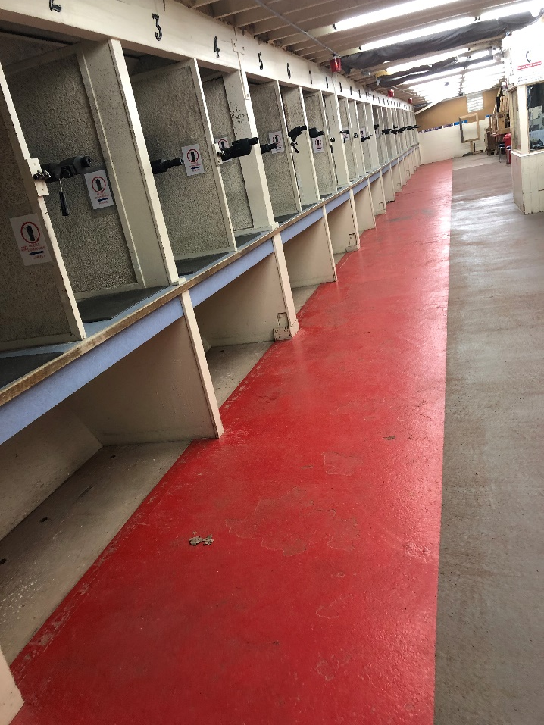
ReVIEW FOR ALL RANGES
Touch no firearms during a ceasefire!
Stay out of the RED zone
Notify the Acting Rangemaster if leaving the range during a ceasefire
The Acting Rangemaster must never leave the range during a ceasefire.
`

Slide 45
REVIEW
What is the earliest shooting time?
Who turns on the ceasefire/safety bell during member-only hours?
As acting Rangemaster for a ceasefire, when checking the line, what three things do you check for to make sure each firearm on the line is safe.
When you squeeze your trigger, your firearm doesn’t fire but only clicks – what should you do?

Slide 46
REVIEW
Who is permitted in the Red Zone while the safety bell is on?
What positions can you use to shoot at 300 yards?
Can a firearm be handled during a ceasefire for any reason?
Who turns off the ceasefire / safety bell?

Slide 47
REVIEW
What distance are the closest targets on Range 1?
A shooter has three firearms uncased at the firing line. How many chamber flags are required?
What tells you that you may have just fired a squib load?
What is the key used for on Range 1?

Slide 48
REVIEW
Where is the safety bell switch located on Range 3?
A Range may be closed for maintenance or events – what should you check before coming?
Your Pistol Special Use says you can shoot a .22 one handed can you shoot your .45 ACP two handed, during member hours? How about during Public hours?
Does a special use endorsement in either Pistol, Rifle, or Archery allow use of the others?

Slide 49
