Slide 1
Welcome to your
Wildlife Committee of Washington
(WCW)
Kenmore Range

Slide 2
Kenmore Range WCW
Wildlife Committee of Washington (WCW) is a not for profit Sportsman's Club
Incorporated in 1945
We are an 80 acre Wildlife Preserve with:
3 Archery ranges
2 Rifle ranges
Pistol range
Shotgun range
Indoor multipurpose range

Slide 3
The Club and Club Members
The club is member run with over 2500 members
Dues are renewed on the anniversary of your joining the club.
To remain an active member, keep dues current
Delinquent membership can be corrected by bringing dues current
Membership can be put into withdrawal for an extended absence.
The club is run by the members. All Board members, Committee chairs, Instructors are club members volunteering their time

Slide 4
So let’s take a look at your club
FITA range
Olympic style archery
Club hosts many tournaments
Archery Flat range
15 targets at 5 yard increments
Lighted range
Notes:
FITA, or Fédération Internationale de Tir à l’Arc – also WA, or World Archery

Slide 5
So lets take a look at your club
Walk thru range
50 plus targets in a natural setting
Indoor range
Seasonal, check calendar
For more info attend the next Archery Committee meeting

Slide 6
So lets take a look at your club
Shot gun Range
4 trap ranges Range master and trappers on duty.
5 stand For competition shoots see club calendar
Member's only nights , Ladies’ Night, and Youth League
For more info attend the next Shotgun Committee Meeting

Slide 7
So lets take a look at your club
Pistol range (range 3)
7, 15, 25, 50 yard target range
Pistol competitions are held here
No drawing from a holster allowed
For more info attend a Handgun Committee meeting

Slide 8
So lets take a look at your club
Members range (range1)
Members only range with 50, 100, 200, 300 yard target frames
Our competition range *see calendar
Rifle range (range 2)
50, 100 yard target range
Public use range with Range master on duty
For more info attend a Rifle Committee meeting
Notes:
Please introduce your self to the other members

Slide 9
You are required to sign in to use the ranges
Sign in sheets are located at each range
Sign in when using the range
Sign out when done using the range
You do not sign in or out when doing maintenance or a work party

Slide 10
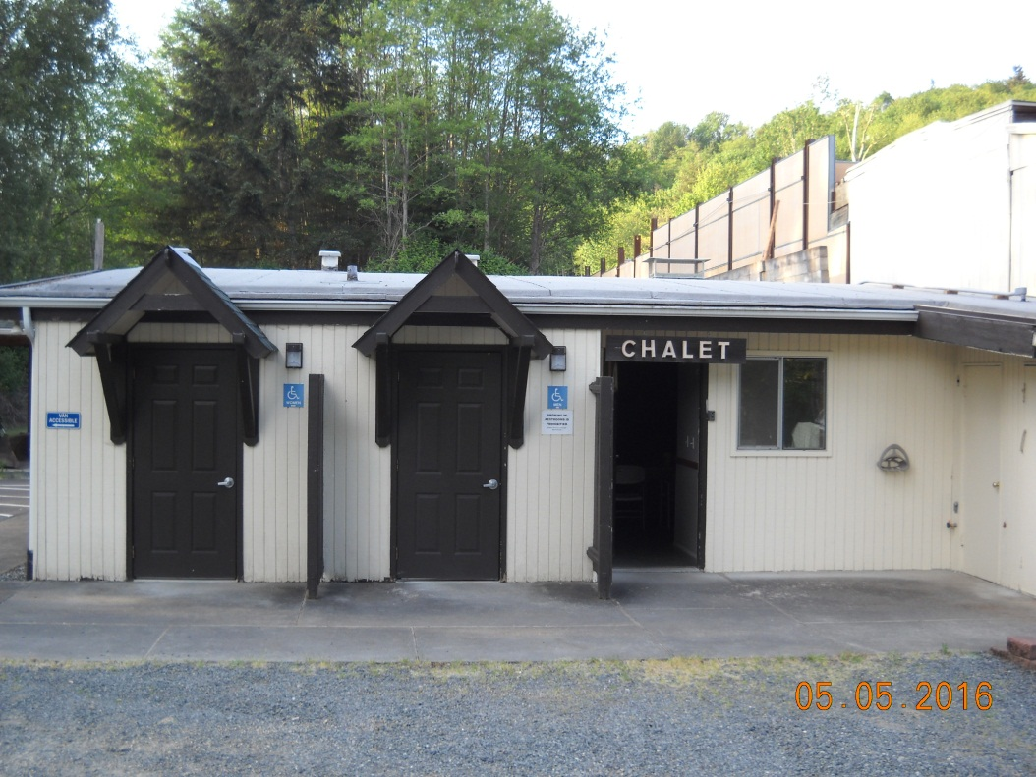
In addition to the ranges we have :
Chalet
Location for:
Archery Committee meetings
Handgun Committee meetings
Rifle Committee meetings
New Member Orientations
Training Classes (too many to list all of them)
Board of Directors meetings

Slide 11
In addition to the ranges we have :
Pistol Range Classroom
Location for:
Training Classes (too many to list all of them)
Over flow if the chalet is in use
Picnic area:
BBQ and picnics
Also used by Hunter Education

Slide 12
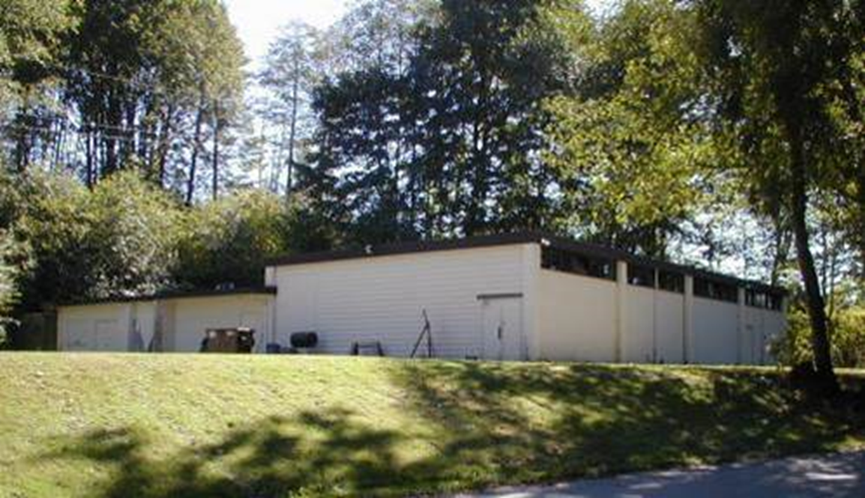
In addition to the ranges we have:
Club House
Quarterly Member Meetings
Hunter Education Classes
Other classes
Swap Meets
Indoor Range:
Archery
Small bore Pistol
Small bore Rifle
Air Gun
Also the location of the armory and shooting sports lockers
**** See Club Calendar for event times and dates ****

Slide 13
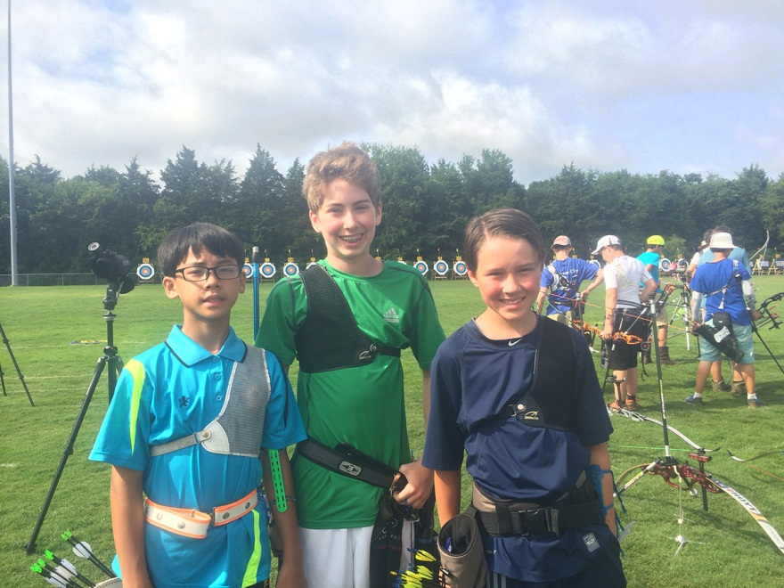
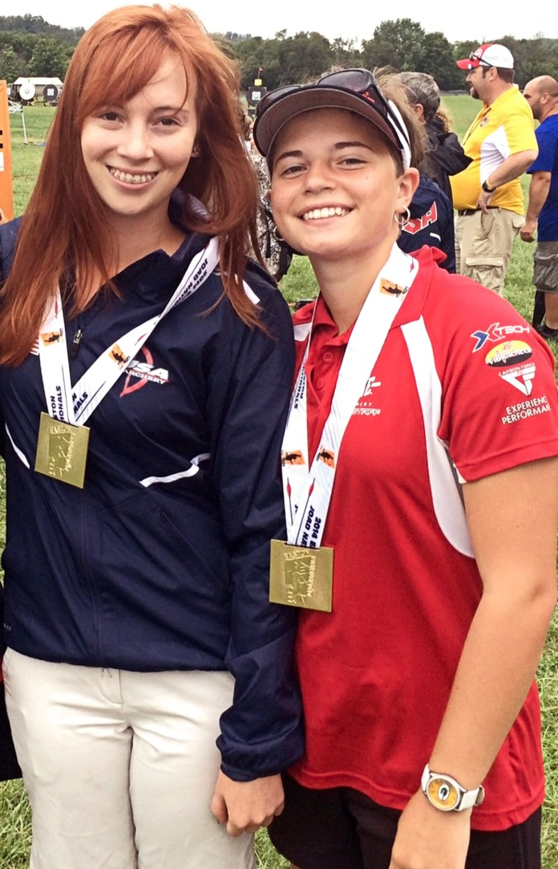
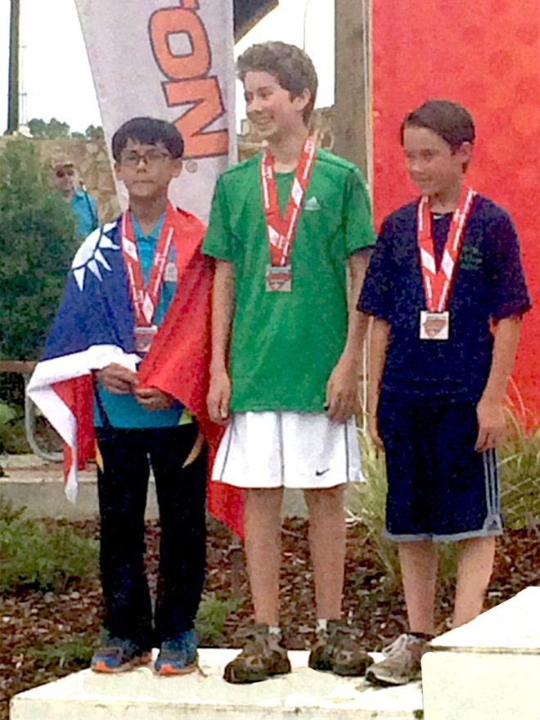
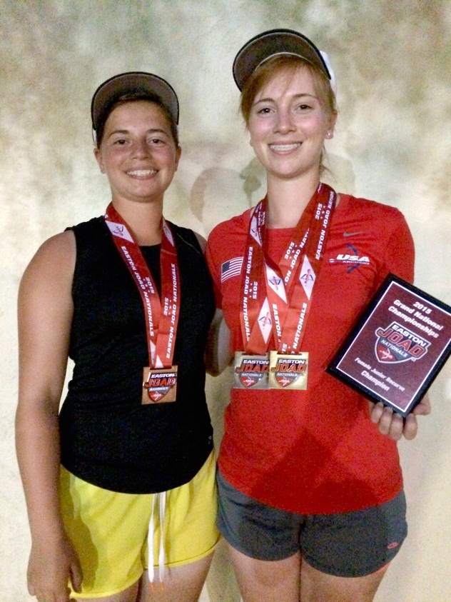
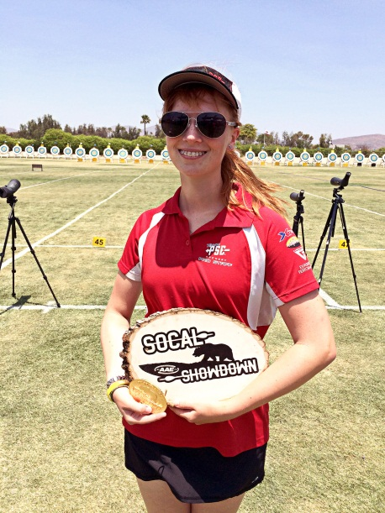
In addition to the ranges we have:
Youth programs
Youth archery ( FITA )
Youth rifle (small bore)
Youth shotgun
**** See Club Calendar for times and dates ****

Slide 14
The Club and its Business
WCW operates our shooting ranges as Kenmore Range – we are open to the public and keeps the club financially viable
The club employees staff the retail end of the club
The retail end of the club is managed by the board of directors
Members receive member pricing at our retail offices

Slide 15
The Club maintained website
Our Website is a treasure trove of information:
wcwi.org
kenmorerange.com
Official club calendar and monthly newsletter
Club information – Committee and Board news, events, rules, bylaws, etc.
E-mail links, e-mail alert list and electronic newsletter sign-ups

Slide 16
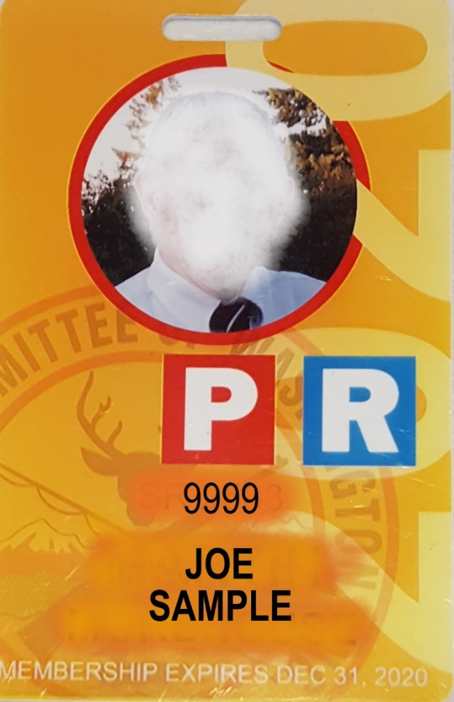
General Club Rules
Membership cards must always be worn in full view
Eye and ear protection must be worn on every range where firearms are in use
Any observed safety hazards or rule violations requires member action
No Intoxicants (alcohol, Herbal or prescription )
No arguing with other members or the public
Club is not responsible for lost or stolen items
Guest policy
You can bring a guest one time during public hours only and you must sign them in at the range office

Slide 17
Club Archery Policy
Some Archery Ranges have equipment restrictions
Attend an Archery committee meeting for an in depth safety and restrictions list
You are the clubs eyes and ears on the archery ranges please take the time to know our policies
SAFETY SAFETY

Slide 18
Shotgun Safety Rules
Actions open and guns unloaded when not on the firing line
Shouldering of guns off the firing line is not permitted
Orange Cone on the trap house means that firing line is CLOSED, No shells can be loaded at a firing line with an Orange cone.
No steel shot can be used
No loads over 2 ¾ inch shell
Shot size 7 1/2 and smaller
Shotgun Safety Rules are found on page 28

Slide 19
Range Policy - Safety
You must take your rifle or pistol cases to the bench or bay you will be firing from before uncasing the firearm.
Uncased firearms must have the action opened, magazine out, and a chamber safety flag inserted before being brought on to a range.
Never ‘sweep’ an adjacent shooter or yourself with the muzzle of your firearm.
Center fire rifles may load up to ten rounds at a time.
Rimfire rifles may up to ten rounds at a time
No one is allowed into the red zone during a cease fire.
No more than one shot every two seconds.

Slide 20
Range Safety
Prohibited Ammo
If its not sold at the range office you need to ask!
Tracers – any and all types
Armor Piercing Ammunition
Steel [or Tungsten] cored bullets and steel jacketed ammunition check with a magnet
All Multi-Projectile loads, for instance:
.410 Winchester ‘PDX’ Disc
12Ga. Buck shot
Black powder ‘Buck and Ball’
Any pistol caliber with “shot” loads

Slide 21
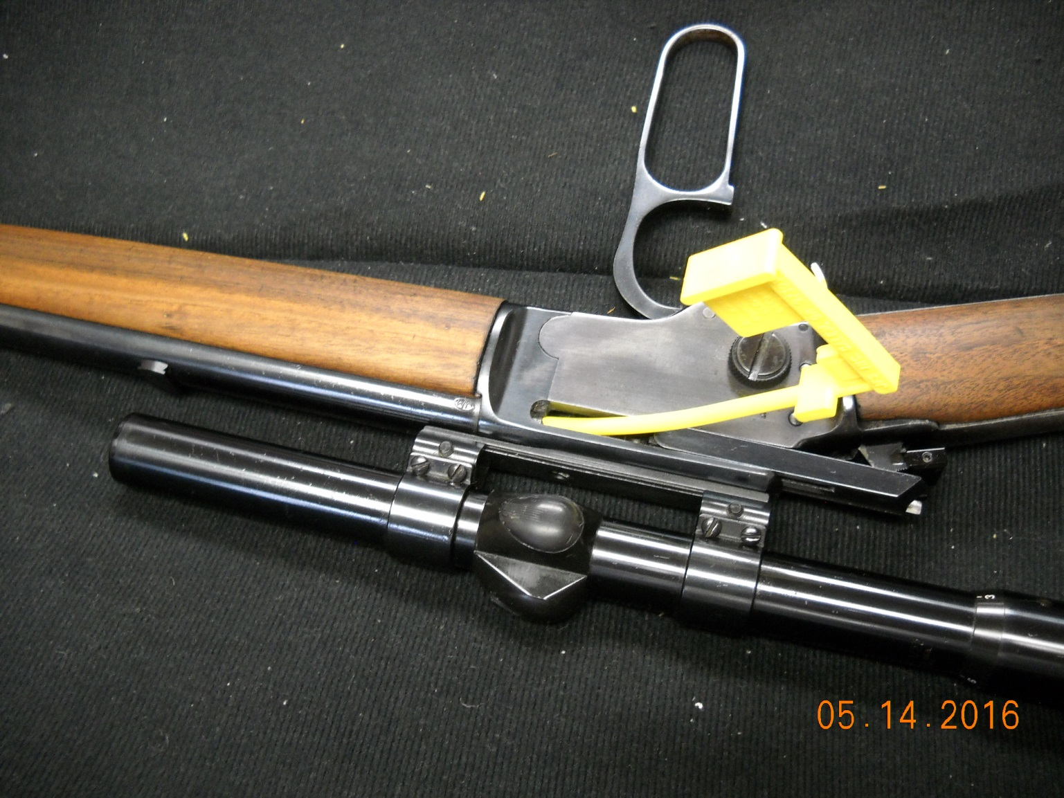
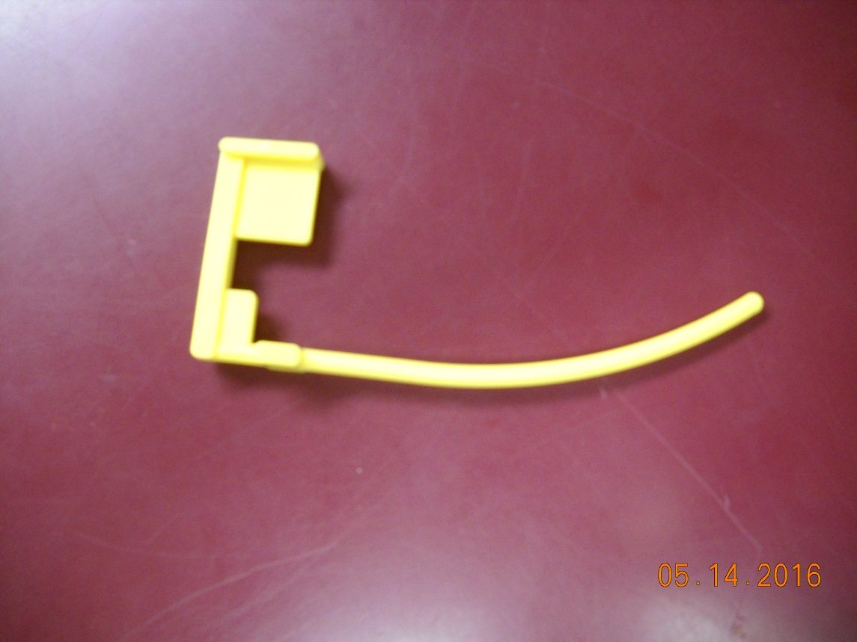
Club Range Policy
The club has ammunition and firearm restrictions
If its not sold at the range office you need to ask or attend a Range committee meeting.
Target restrictions No silhouettes No caricatures
Chamber Flag are required in all firearms
No one is allowed in the red zone during a cease fire!! Bell On, Light On
SAFETY SAFETY

Slide 22
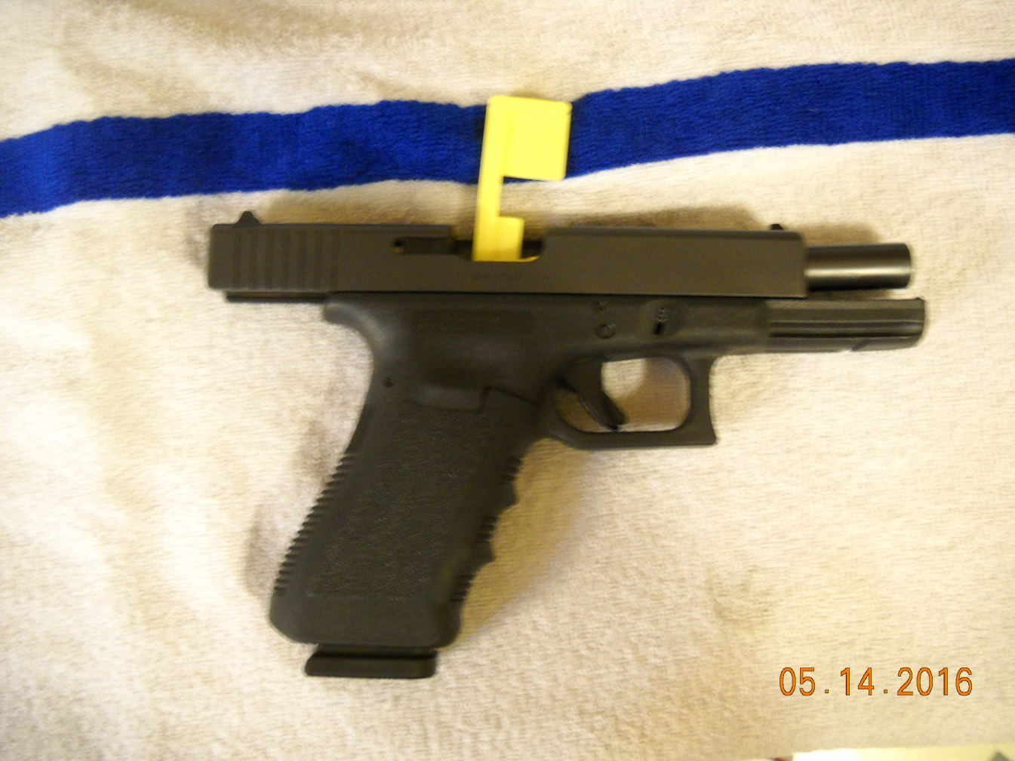
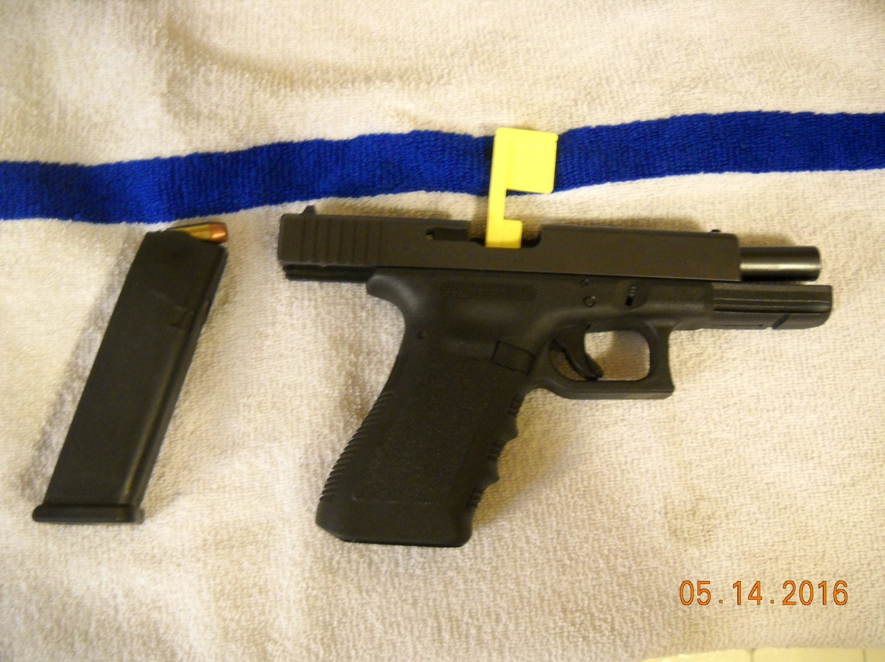
Is this safe for ceasefire

Slide 23
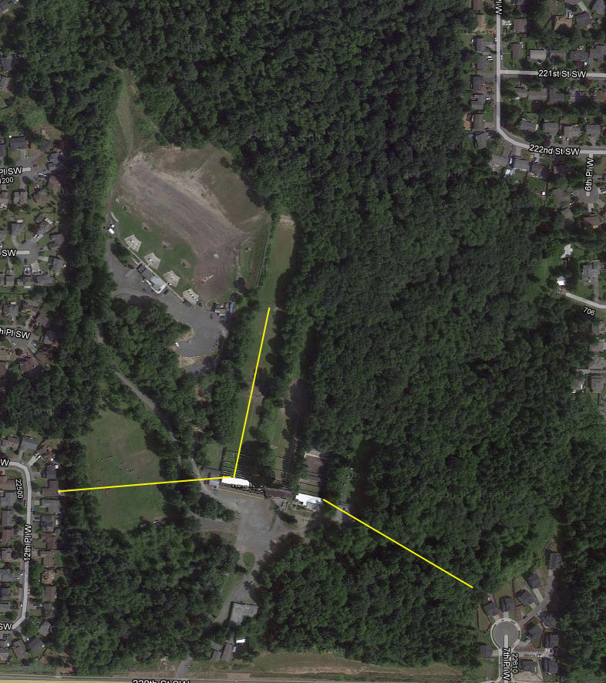
S A F E T Y
Your neighbors are close
Our neighbors are 200 yards from your gun’s muzzle

Slide 24
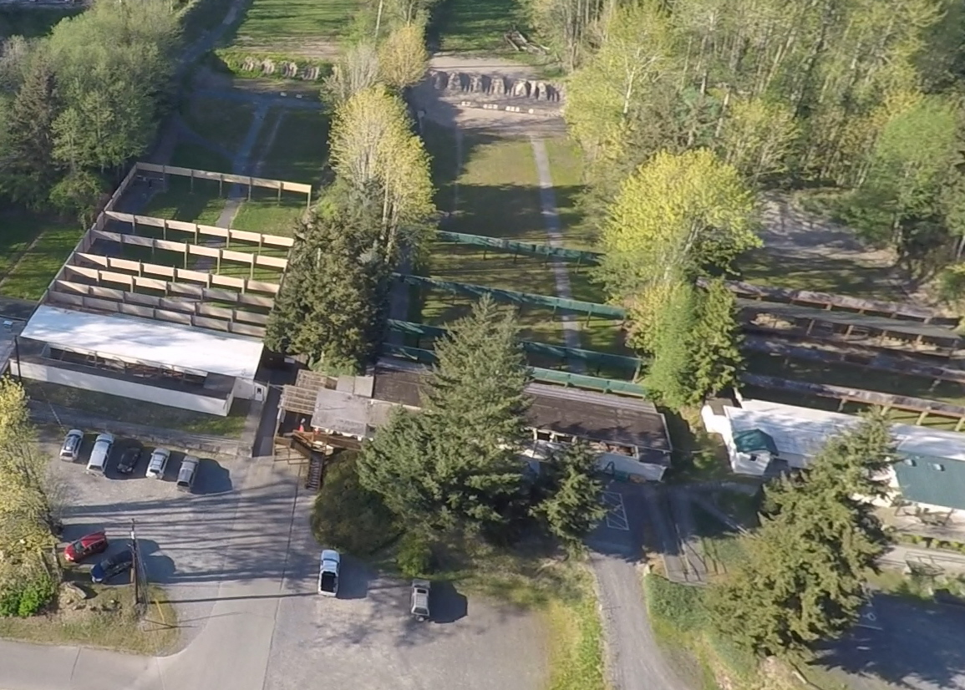
Safety – Our Baffle System
Range 1 Range 2 Range 3

Slide 25
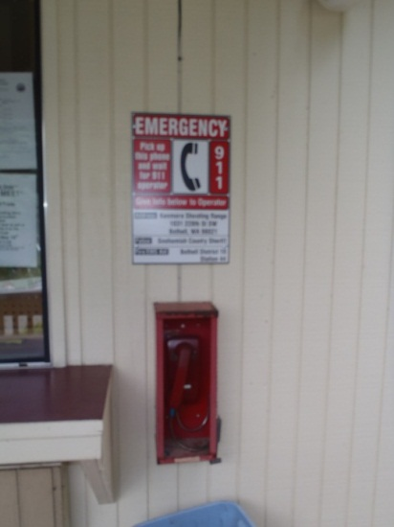
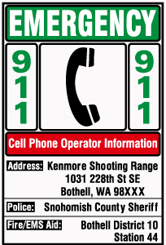
EMERGENCY INFORMATION
There is a direct dial 911 phone at the Range number 2 (public) Office.
There are phones located inside the Pistol and Shotgun Offices.
You must tell the 911 dispatcher:
Where we are located
Which responder services our club location
These signs are placed at each range and in every building

Slide 26
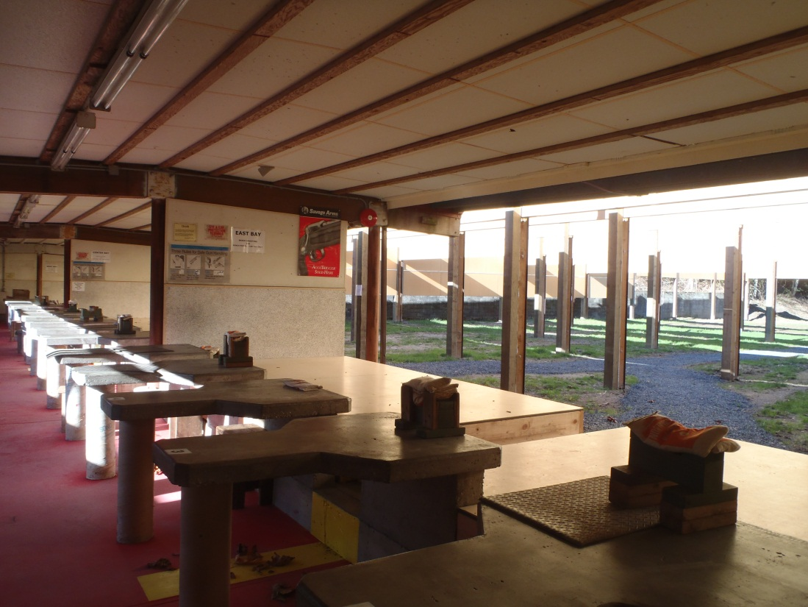
Rifle and Pistol Ranges

Slide 27
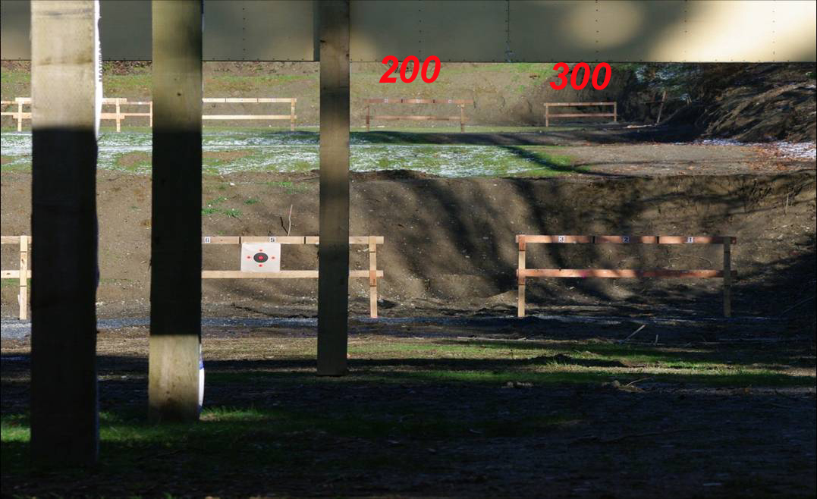
Target Frames(200/300yds)
To use 200 yard targets, take down the 300yd frames. Or shoot 300 if you take down the 200 yard frames. Same with 50 or 100 yard targets.
Unused target frames or posts are placed in the racks provided.

Slide 28
Pistol Matches
ISSF Free Pistol: Slow fire .22 Olympic event. 20 rounds in 30 minutes. 60 round match. .22LR. Total time 1hr 45 min.
ISSF Air Pistol League: Slow fire Olympic event, 10 meter .177 air pistol, series of 1/2 course (30 rounds in 1 hr) matches, aggregate of 8 weeks.
ISSF Outdoor Standard Pistol League: Series of 8 matches, aggregate of 8 weeks, slow, timed, rapid, 50' reduced target, .22LR standard velocity
ISSF Centerfire/Sport Pistol League: Series of 8 matches, aggregate of 8 weeks, slow and duel, either Centerfire: .38, .32 or Sport: .22LR
NRA Bullseye: .22LR Indoor Postal League: Participation in the Spokesman-Review (50 foot indoor) postal league, 10 half course matches submitted for postal score, 8 full course matches for WCW league score, slow, timed, rapid, .22LR, any sight Training: ISSF and Bullseye: 3 hours of training using outdoor turning targets. 10 and 20 sec training for Standard Pistol and Bullseye. Bring about 400 rounds for .22LR, Centerfire or 45ACP.
Notes:
28

Slide 29
Rifle Matches
NRA Highpower and Civilian Marksmanship Program matches: 4-position match
Rimfire Benchrest: 100 yds, any rimfire
Benchrest Rifle: Factory/Custom classes, 300 yds, 200 yrds
Cast Bullet Match: modern rifles using cast bullets at 200yds
Smallbore Rifle Team League - Puget Sound Rifleman's Association: 22LR, 50' indoor, postal league
Youth Rifle: Junior smallbore teams
Notes:
29

Slide 30
Special Use Membership Endorsements
Required to use:
Range #1 and FITA range; not open to the public .
Members only hours
Special use is only granted thru the Archery, Handgun, and Rifle Committees and requires training on safety and club policies
Pistol and rifle qualifications are required

Slide 31
Hunter Education
Hunter Education on-line registrations, (and the entire schedule for the year for all classes in the state) can be found at the WDFW; state department of fish and wildlife:
http://www.wdfw.wa.gov/hunting/huntered/
The club will help get new instructors certified by the State
For more information, contact:
Horacio DelGado
206-551-5151

Slide 32
Firearms Training
The club offers a variety of NRA certified classes:
Home Firearm Safety
Basic Rifle
First Steps Shotgun
Basics of Pistol Shooting
Instructor Training/Certification
Visit Education and Training section of www.wcwi.org or
For more information, contact:
Richard Ripley
(206) 271-0670

Slide 33
Charities we participate in
Toys for Tots
Paralyzed Veteran’s shoots
Women Victims of Domestic Violence
We donate time or funds to many northwest and international organizations such as NRA, RMEF, Ducks unlimited, just to name a few

Slide 34
Topics for Members
Discarded brass
Summer picnic
3D shoot
Firearms serial #
NRA membership
Second Amendment Foundation
CCRKBA
3 closed days
CPL on premises

Slide 35
Topics for Members, cont.
This is your club
Other public outreach; parades, events
Identify yourself at Range Office
Restroom locations
Waiver form
Email address on waiver

Slide 37
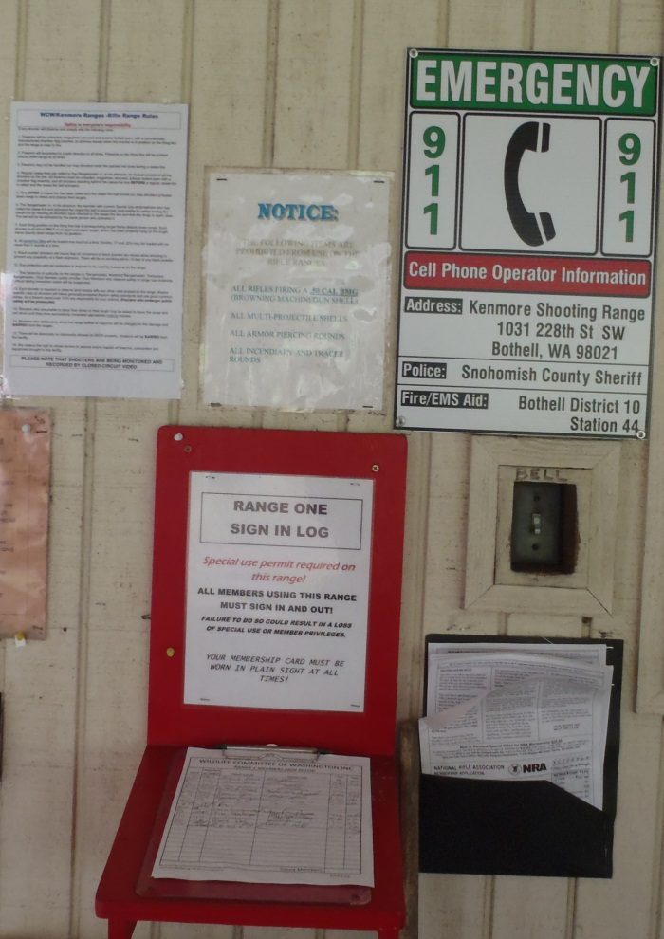
Summary
Members must:
Follow all rules and policies
Enforce all rules and policies
Wear membership cards at all times
Sign in and out ==➔
Treat everyone with respect

Slide 38
Summary
Members are expected to be familiar with all club rules and safety procedures
Members are expected to ensure everyone is observing the rules and bylaws.
Should an offending party refuse to comply with our rules, contact range master
Club Members who observe safety violations without taking immediate action can be suspended . (Bring safety concerns to a committee meeting)
Notes:
38

Slide 39
Survey
Does this new member orientation work for you?
Should the club offer the same information in a walk around the ranges instead?
Does this evening meeting fit your schedule, or would an hour on a weekend work better?
Notes:
39

Slide 40
Common Questions
What does an orange cone on a trap house mean ?
What direction should a shotgun be pointed ?
Is steel shot allowed on the shotgun range ?
Who is permitted in the red zone while the safety bell is on ?
A shooter arrives with 3 firearms. How many chamber flags are required ?
Can a firearm be cased or uncased during a ceasefire ?

Slide 41
Common Questions, cont.
Can a firearm be brought to the range office at any time without a chamber flag in its chamber ?
Can children under 21 years of age be at the pistol range ?
Which direction must a firearm be pointed under all conditions at the rifle and pistol ranges ?
What procedure is to be followed when an unsafe condition or violation is observed ?
Under what conditions can a shotgun be fired at the rifle range ?

Slide 42
Common Questions, cont.
Do safety glasses and ear plugs/muffs need to be worn at all times on the pistol and rifle ranges ?
What type of safety protection needs to be worn on shotgun range ?
Can a shooter draw their firearm from a holster at the pistol range ?
Can a shotgun be placed to your shoulder inside the shotgun shack at any time ?
Under what conditions can a rifle be loaded with more than one cartridge ?

Slide 43
That’s it… Congratulations and enjoy YOUR club!

